Slide 1



Hackathon Journey
24 Hours of Building, Failing, and Learning
The best lessons never came from winning.
They came from the messy, exhausting process
3KA
HUỲNH AN KHƯƠNG
NGUYỄN QUỐC HUY
NGÔ QUANG KHÔI
HOÀNG LÊ THÀNH ĐỨC
ĐẶNG NGUYỄN PHƯỚC LỘC
ĐẶNG TRƯỜNG HƯNG
The Hackathon Journey

Slide 2

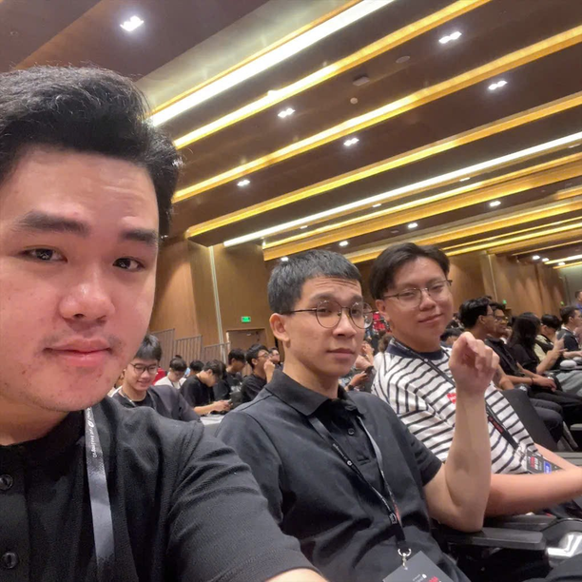
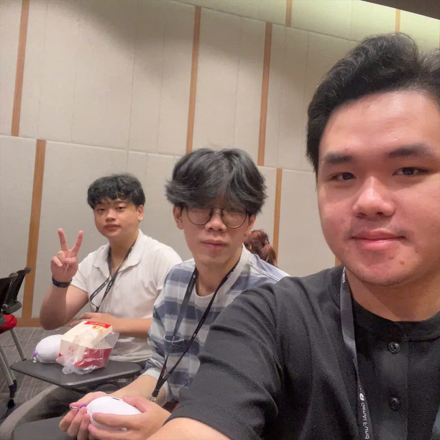
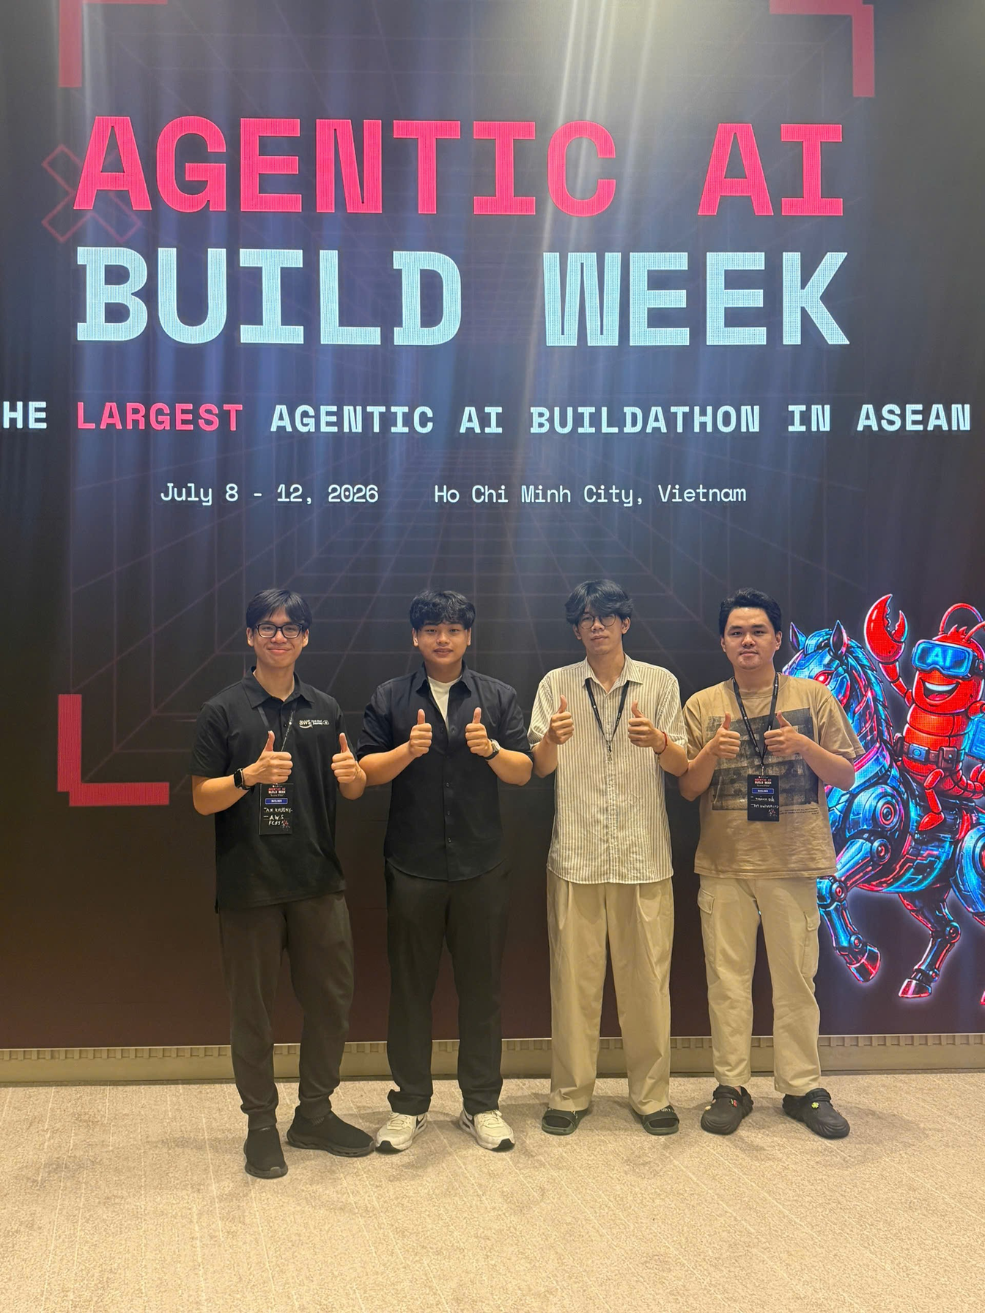
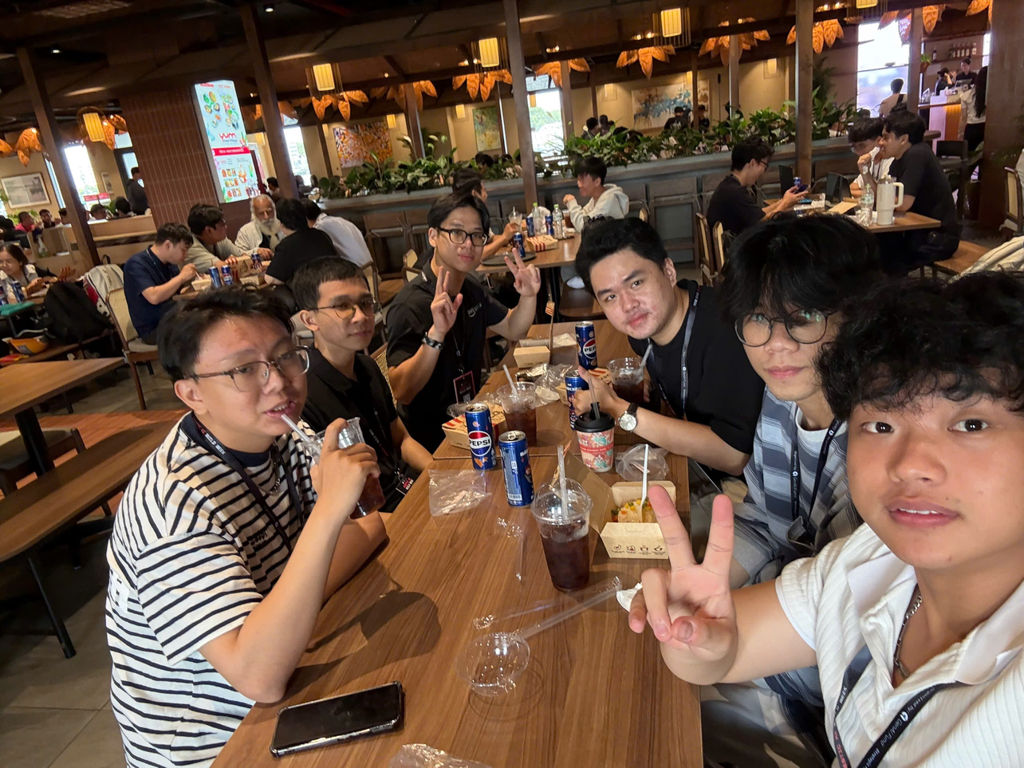
MEET TEAM 3KA
The Hackathon Journey
15

Slide 3

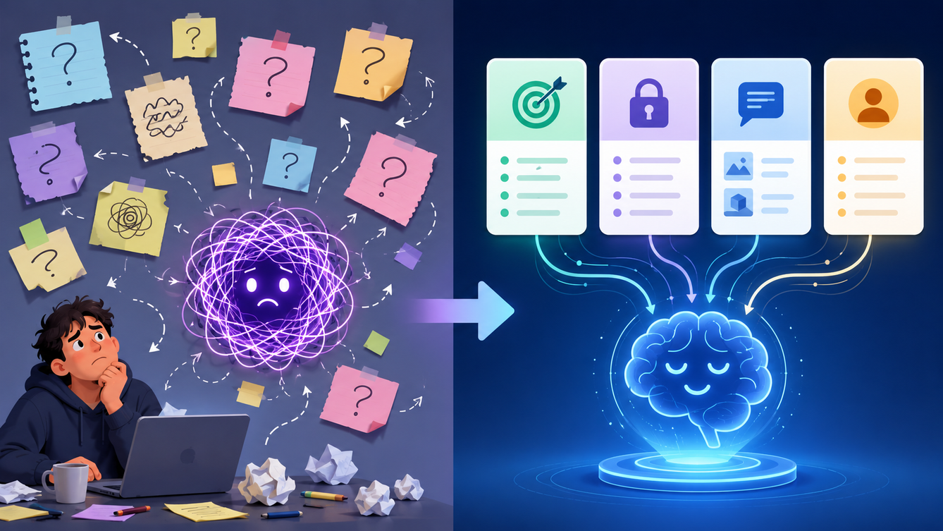
The Journey Ahead
Four stages of our hackathon
Signing up & choosing a track
01
How it all began: nerves, curiosity, a leap.
Building under pressure
02
24 hours of coding, food, and chaos.
Demo day & judging
03
Pitching our idea to the judges.
Lessons & reflections
04
What we'd tell my past self before day one.
The Hackathon Journey
2

Slide 4
Why Did We Join?
Challenge ourselves beyond the classroom.
Gain hands-on experience with AI and AWS
Learn how real hackathons work
Build an end-to-end MVP under time pressure
Collaborate with teammates in a fast-paced environment
The Hackathon Journey
10

Slide 5

The Fears Before Day One
Every first-timer faces the same doubts before starting.
Not skilled enough
Too little time
Fear of failing
Clueless
The Hackathon Journey
3

Slide 6
The Emotional Rollercoaster
How 24 hours actually felt.
1
Overwhelmed
Where do we even start?
2
In the zone
The idea starts to click
3
Proud
We actually built it
DOUBT
FLOW
PRIDE
The Hackathon Journey
9

Slide 7
Project Overview
S.H.E.P.H.E.R.D
Smart Human-flow Evaluation, Prediction, Hazard Detection, Response, and Dispatch
Originally planned as our Capstone project, we chose to prototype it during the AABW to validate the idea and gain real-world development experience
Our goal
Build with
Detect crowd density
Monitor queue conditions
Estimate congestion with Operation Agent
Alert operators and dispact in real time
YOLO + ByteTrack
Amazon SageMaker
Amazon Bedrock AgentCore + Strands Agent
React Monitoring Dashboard
The Hackathon Journey
11

Slide 8

The Problem & Inspiration
The Problem
Venue staff must monitor entrances, queues, booths, and crowd movement across multiple areas at the same time.
Manual monitoring can be:
Slow and reactive
Difficult to scale
Prone to missed incidents
Ineffective when conditions change quickly
Our Inspiration
We wanted to build a system that helps operators detect problems earlier and respond before congestion becomes serious.
The Hackathon Journey
13

Slide 9
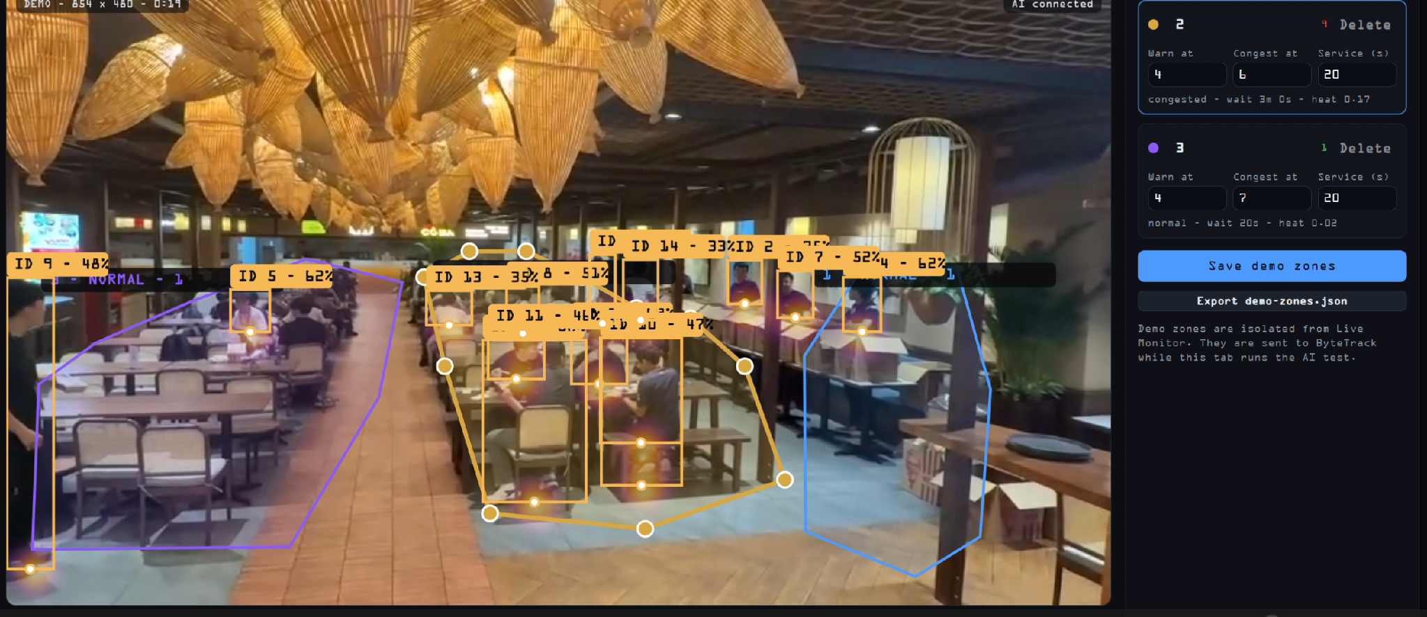
What It Does
Core Capabilities
S.H.E.P.H.E.R.D. analyzes live camera footage to:
Detect and track people
Measure crowd density
Estimate queue conditions
Identify early signs of congestion
Predict overcrowding pressure
Create proactive alerts
Recommend staff actions
The system turns ordinary camera footage into clear operational information.
The Hackathon Journey
4

Slide 10
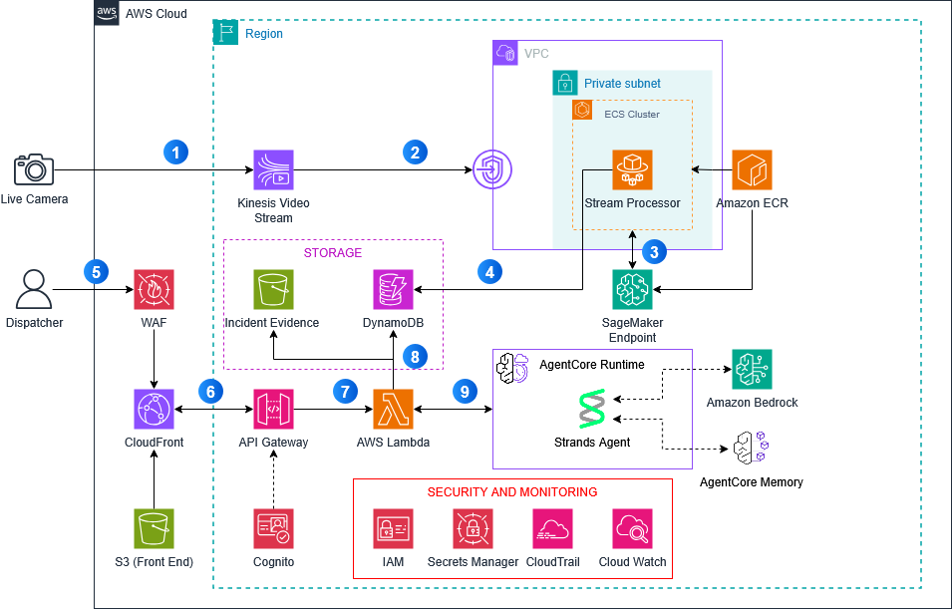
Architecture
The Hackathon Journey
4

Slide 11
Agentic AI Layer
Autonomous Monitor
Continuously monitors live crowd metrics
Detects signs of congestion
Predicts possible overcrowding
Creates proactive alerts
Operator Copilot
Lets staff ask natural-language questions and receive concise answers backed by live metrics, prediction tools and actions.
The Hackathon Journey
6

Slide 12
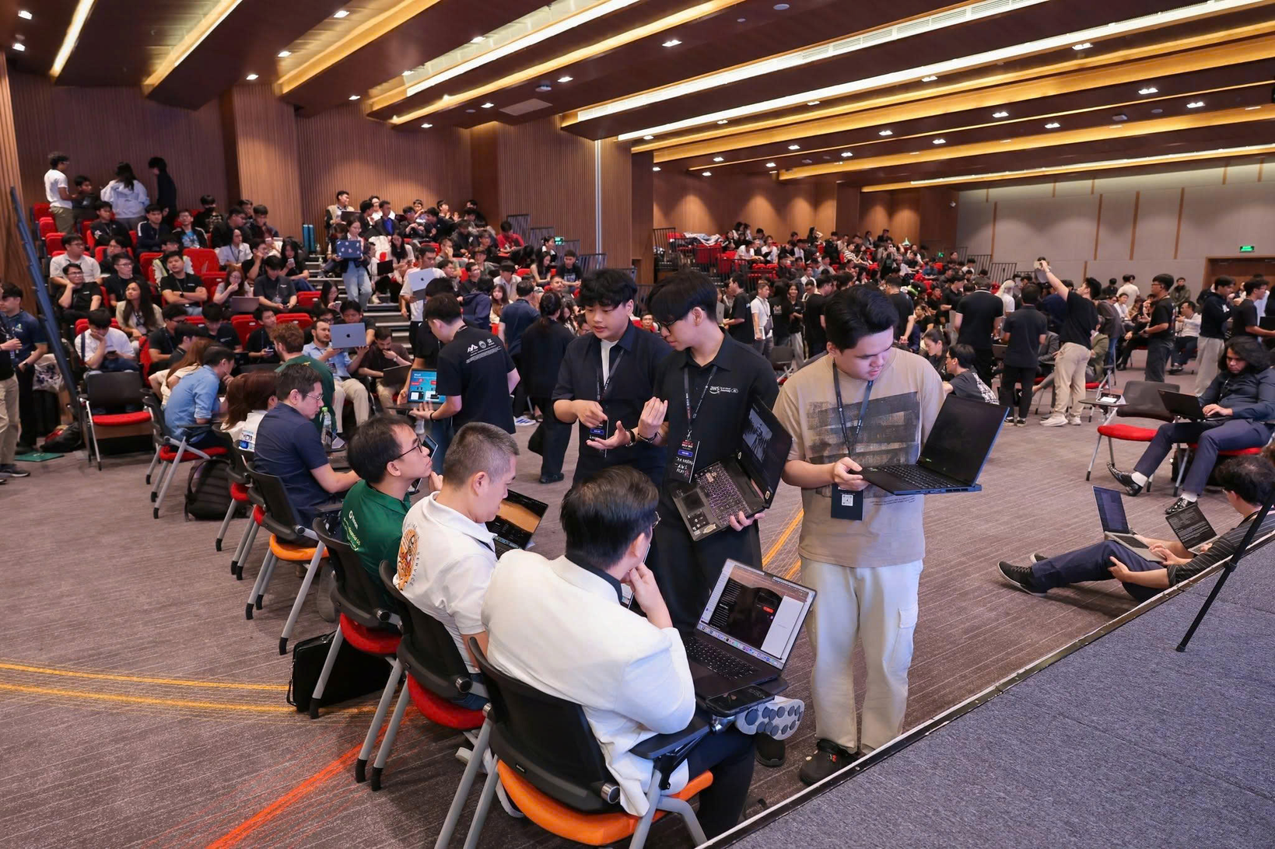
DEMO
The Hackathon Journey
4

Slide 13
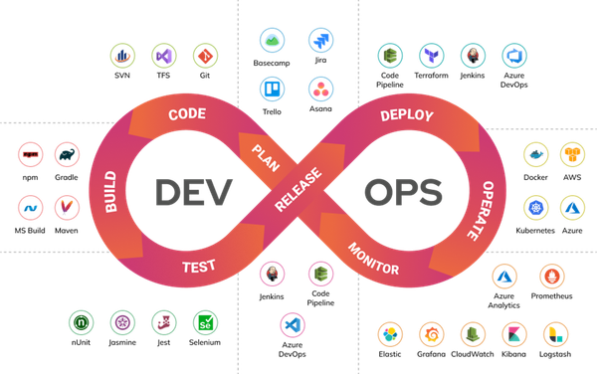
What We Learned & Challenges
What We Learned
Main Challenges
We learned how to combine:
Real-time computer vision
Object tracking
Cloud inference
Operational dashboards
Agentic AI
Maintaining reliable live video
Reducing inference latency
Preserving tracking between frames
Selecting effective camera positions
Keeping the system achievable within the hackathon timeline
Making the AI agent proactive, explainable, and actionable
Cost
The Hackathon Journey
7

Slide 14

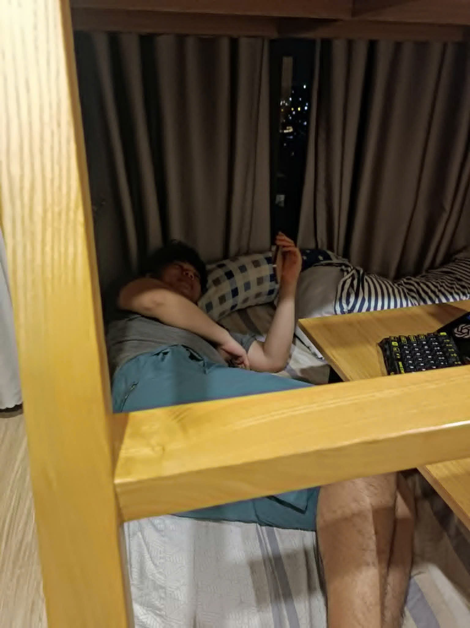


Biggest Challenges
At that time, we faced several challenges. These are the ones that are the biggest:
No AI Background
First time working with AWS
Limited amount of time
Code didn’t work
Sleep deprivation
The Hackathon Journey
13

Slide 15
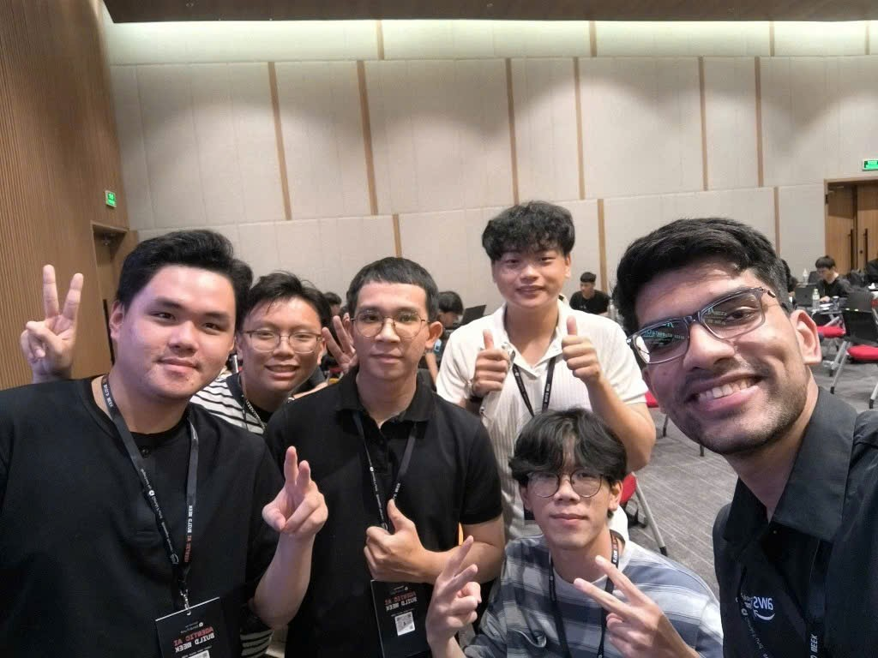
Fun Experiences
Even though there were hardships, we still found joys in that day
Took a stroll around VinHome at midnight
Forgot to commit code
Got quarrel because we didn’t know who did what
Debugging until 3AM the next day
Accidentally pushed env file onto Github
Drank 5 redbulls.
Ate a lot KFC and snacks.
Met amazing people
The Hackathon Journey
13

Slide 16
What I'd Prepare Next Time
Four things that make the weekend smoother.
A clear goal
Know what “done” looks like early
A ready toolkit
Starter templates and accounts set up
Defined roles
Who codes, who designs, who pitches
A demo plan
Rehearse the three-minute story
Preparation isn't cheating.
It's what lets you focus on building.
The Hackathon Journey
12

Slide 17
Tips for Your First Hackathon
What I wish someone had told me.
Just sign up
Find a team early
Don't wait until you feel ready
Different skills beat identical ones
Scope it tiny
Talk to everyone
One feature, done well
Mentors and teams are why you're there
The Hackathon Journey
13

Slide 18
Key Takeaways
Three things I'm taking with me.
1
2
3
Showing up
is already half the battle.
Small, finished work
beats big, broken ideas.
The people you meet
matter more than the prize.
A hackathon isn't just a competition.
It's where you find out what you can build.
The Hackathon Journey
15

Slide 19

Q&A
Thank you!
Ask me anything about the hackathon, the build, or getting started.
The Hackathon Journey
16

